Slide 1
Perfectly Privacy-Preserving AI
2020.4.10
Zhang zhong

Slide 2
Table of contents
Motivation and Problem
Method
Future work

Slide 3
Motivation and Problem
Data privacy is an important issue
To training and testing AI models, a lot of data is needed. (sensitive data)
Data privacy while training and testing AI models
No related works (no guides published regarding perfectly privacy-preserving AI)

Slide 4
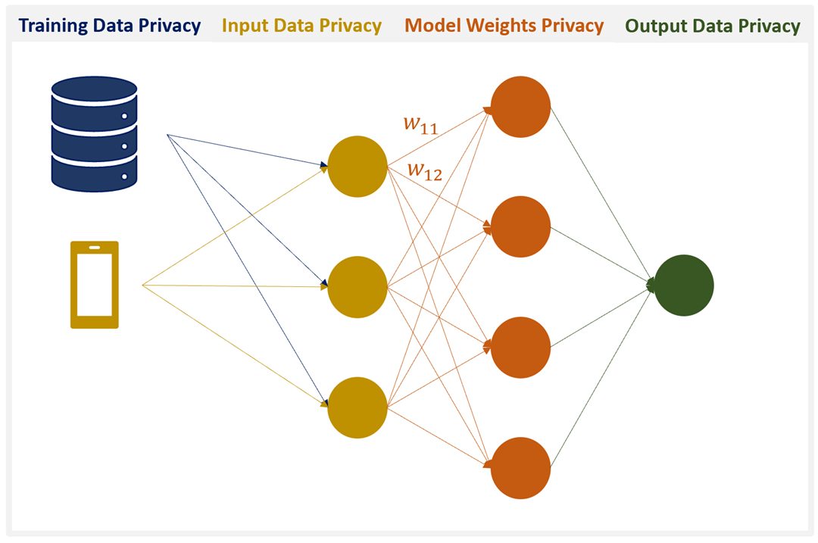
Method
2: cannot be observed by others
3: output of a model is not visible by others
Four pillars required to achieve perfectly privacy-preserving AI
1: cannot reverse-engineer the training data
1, 2, 3: Protect user information
4: Protect the model
4: model cannot be stolen by attacker

Slide 5
Training data privacy
Differentially Private Stochastic Gradient Descent (DPSGD): (differential privacy: describing the patterns of groups within the dataset)
Papernot’s PATE: transfers to a “student” model the knowledge of an ensemble of “teacher” models, training teachers will provide disjoint data and strong privacy. (It also uses differential privacy)
Guarantee privacy, and improve the generalizability of machine learning models

Slide 6
Input and output privacy
Homomorphic Encryption: training & inference can be performed directly on encrypted data
Secure Multiparty Computation (MPC): distributes a computation across multiple parties where no individual party can see the other parties' data.
Federated Learning: on-device machine learning, it should be combined with differentially private training and MPC.

Slide 7
Model privacy
Applying differential privacy to model outputs to prevent model inversion attacks (compromising model accuracy)
Homomorphic encryption can be used (does not prevent model inversion attacks)

Slide 8
Future work
Still no blanket technology that will cover all Four Pillars
Homomorphic Encryption + Differential Privacy
Secure Multiparty Computation + Differential Privacy
Federated Learning + Differential Privacy + Secure Multiparty Computation
Homomorphic Encryption + PATE
Secure Multiparty Computation + PATE
Federated Learning + PATE + Homomorphic Encryption

Slide 9
Privacy-Preserving Machine Learning Tools
Differential privacy in Tensorflow
MPC and Federated Learning in PyTorch
MPC in Tensorflow
On-device Machine Learning with CoreML3

Slide 10
A Survey on Collaborative Deep Learning and Privacy-Preserving

Slide 11
Table of contents
Motivation
Problem
Method
Summary

Slide 12
Motivation
collaborative deep learning: Federated learning, many data from multiple devices
privacy

Slide 13
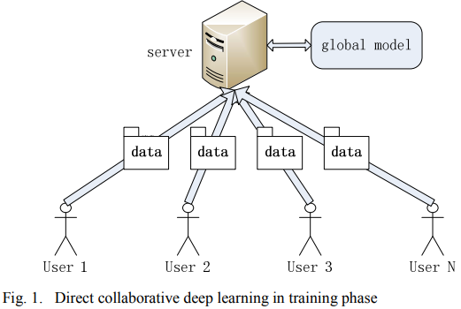
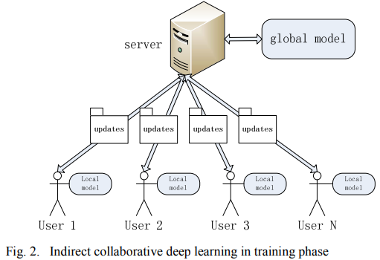
Collaborative deep learning
Data do not leave the user’s device

Slide 14
Problem 1
The server is malicious

Slide 15
Problem 2
The user is malicious
2. Model with labels it doesn’t have
1. false gradient information
3. infer information about labels

Slide 16
Problem 3
Servers and users are malicious:
a malicious server collaborates with a malicious user/some users
some users are malicious and collusion.

Slide 17
Method 1
Direct collaborative deep learning:
Many works using homomorphic encryption to protect the users data.
differential privacy to prevent attacker to identify individuals.
perturbation mechanism against estimation attack.

Slide 18
Method 2
Indirect Collaborative Deep Learning:
To prevent collusion, public-key infrastructure (PKI) (to make sure all users are trusted)
Secure Multiparty Computation (MPC), share small subsets of their models’ key parameters during training. “Privacy-preserving deep learning”
differential privacy prevents inference
asynchronous parameter exchange against malicious user
User uploads the trained non-sensitive data to the server to continue training
fully decentralized peer-to-peer network

Slide 19
Method 3
Privacy-preserving during Using phase:
homomorphic encryption (maintain high accuracy, may cause high performance overhead)

Slide 20
Summary
Besides Homomorphic Encryption, Differential Privacy, Secure Multiparty Computation, and Federated Learning
We can use PKI, decentralization (Blockchain), asynchronous technique, perturbation mechanism
Homomorphic Encryption may cause high performance problem, Differential Privacy may reduce the accuracy.

Slide 21
Thank you

